Slide 1
Seq-to-Seq
Hands-on ML/DL
Ref: http://jalammar.github.io/visualizing-neural-machine-translation-mechanics-of-seq2seq-models-with-attention

Slide 2
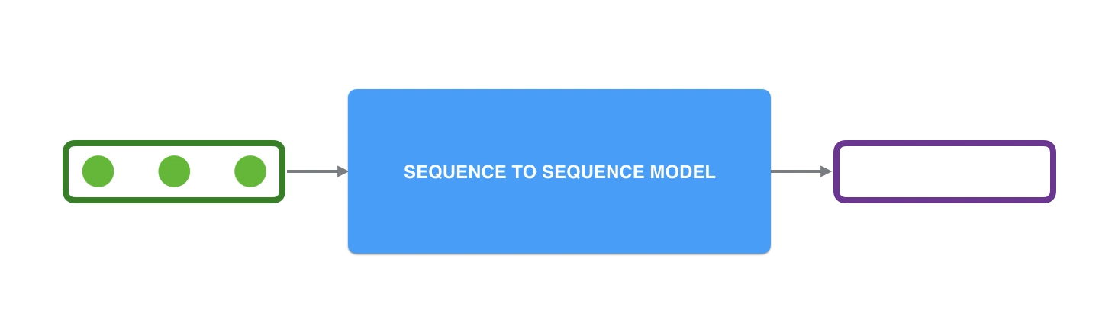
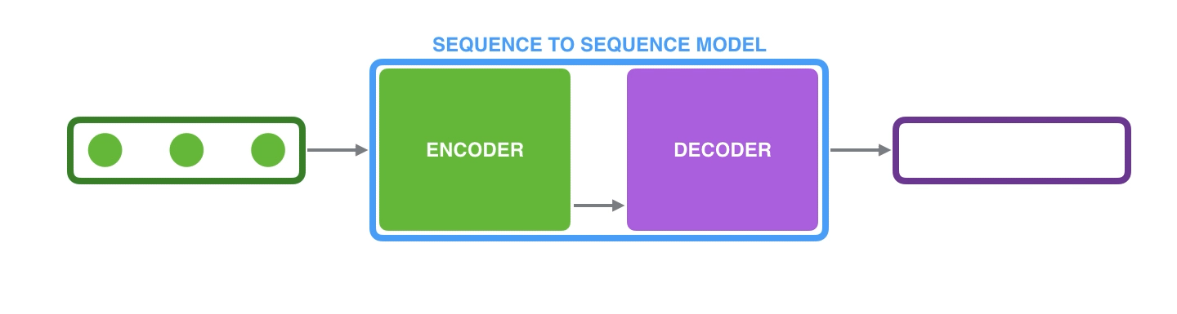
Encoder-Decoder

Slide 3
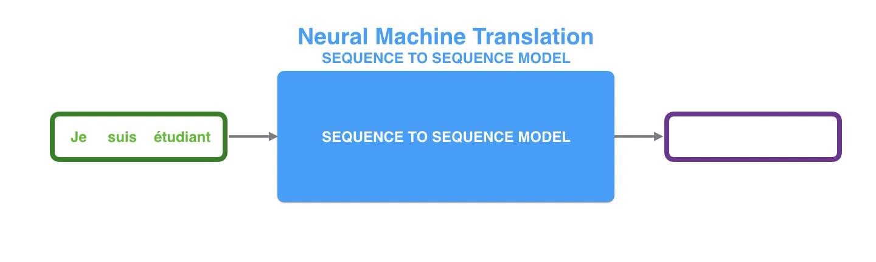
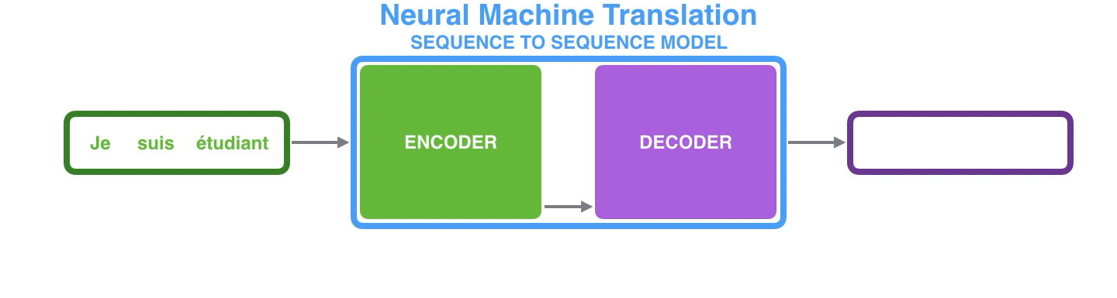
Machine Translation

Slide 4
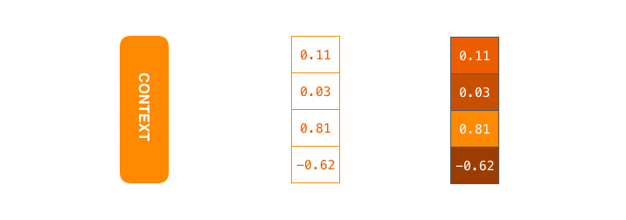
The Context
The context is a vector of floats. Later in this post we will visualize vectors in colour by assigning brighter colours to the cells with higher values.

Slide 5
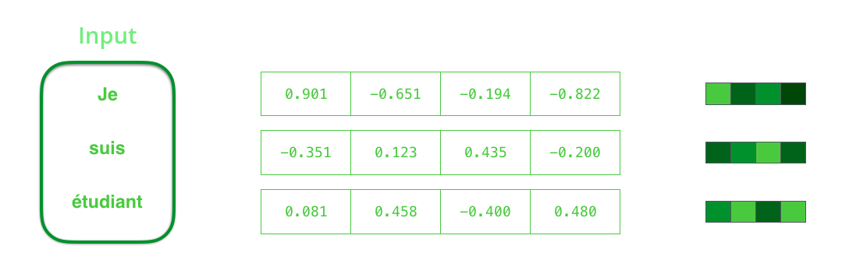
The Input Word Embedding
We need to turn the input words into vectors before processing them. That transformation is done using a word embedding algorithm. We can use pre-trained embeddings or train our own embedding on our dataset. Embedding vectors of size 200 or 300 are typical, we're showing a vector of size four for simplicity.

Slide 6
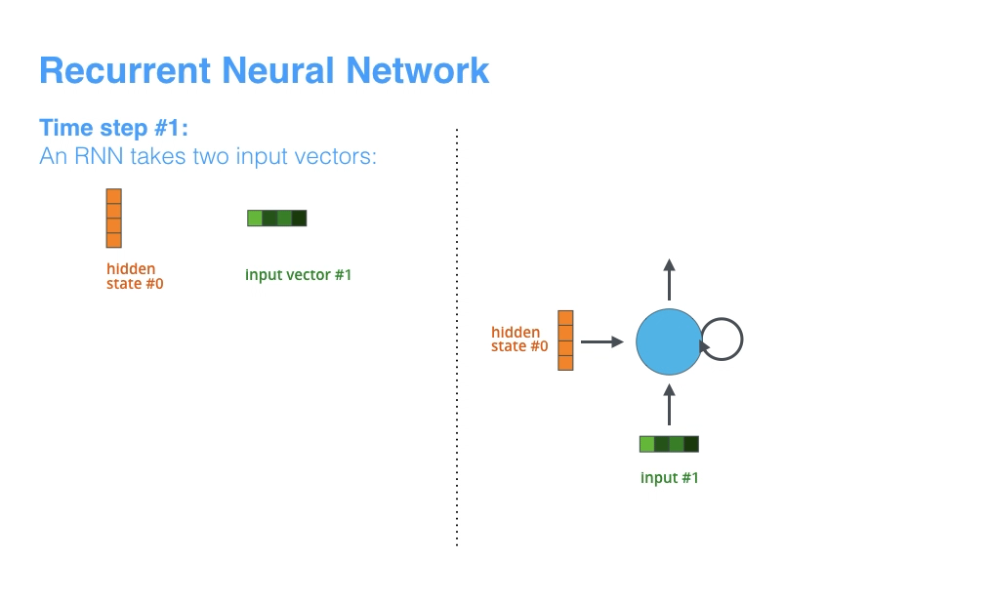
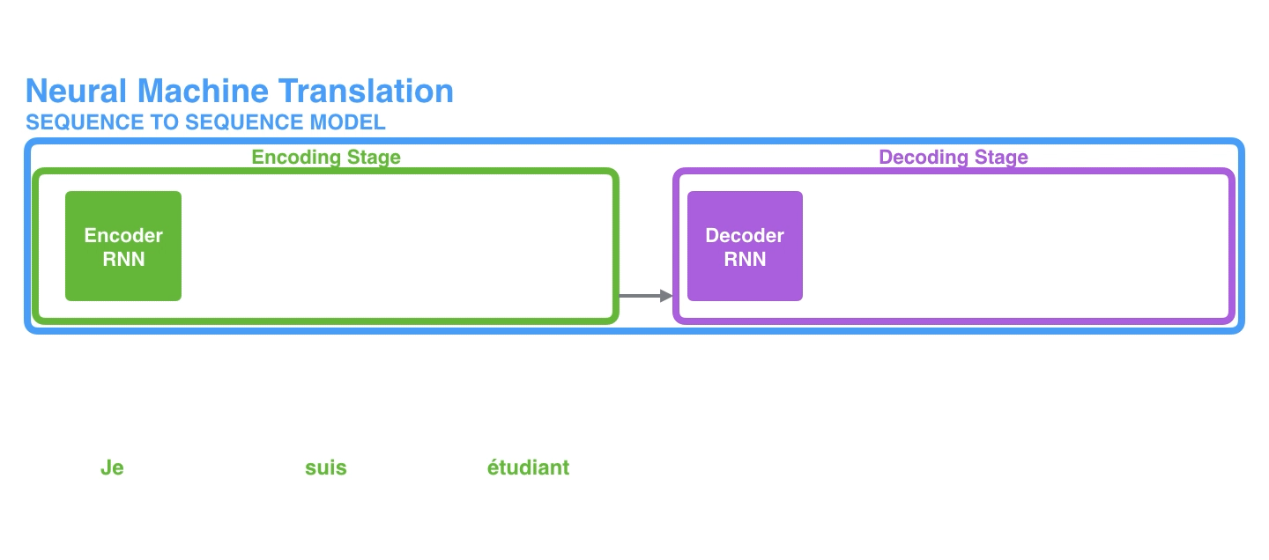
RNN
Notice how the last hidden state is actually the context we pass along to the decoder.

Slide 7
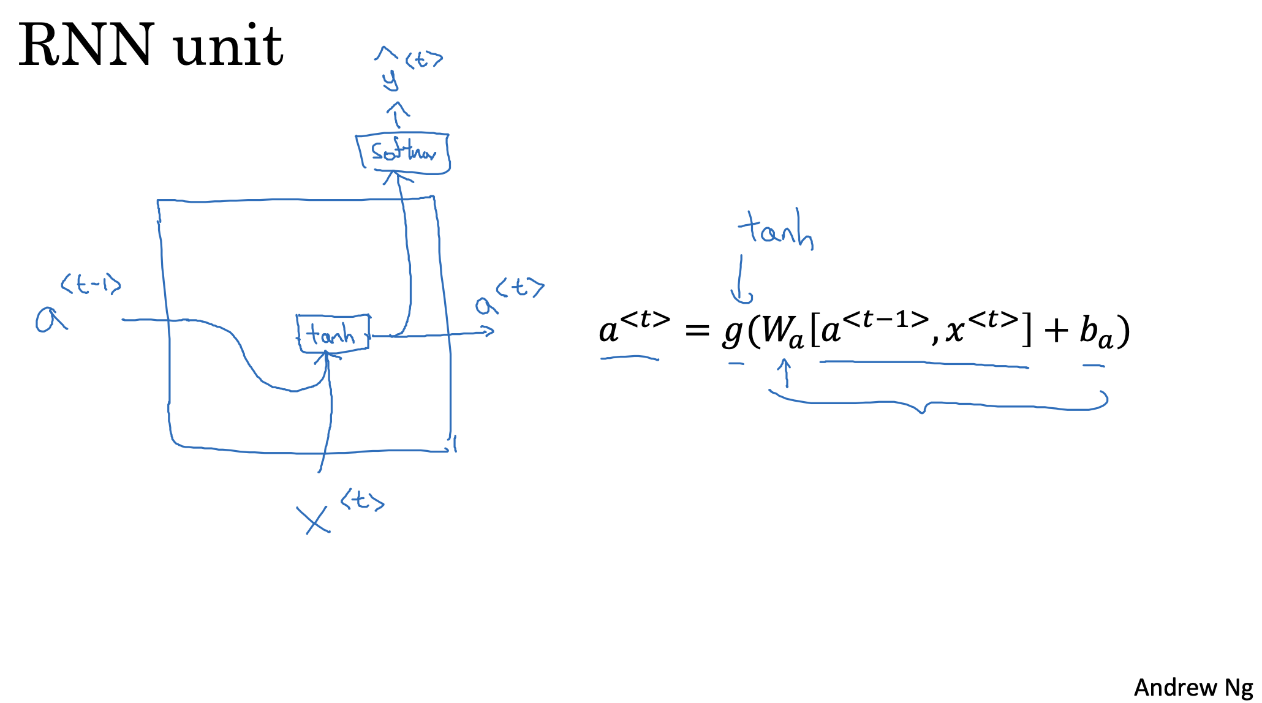
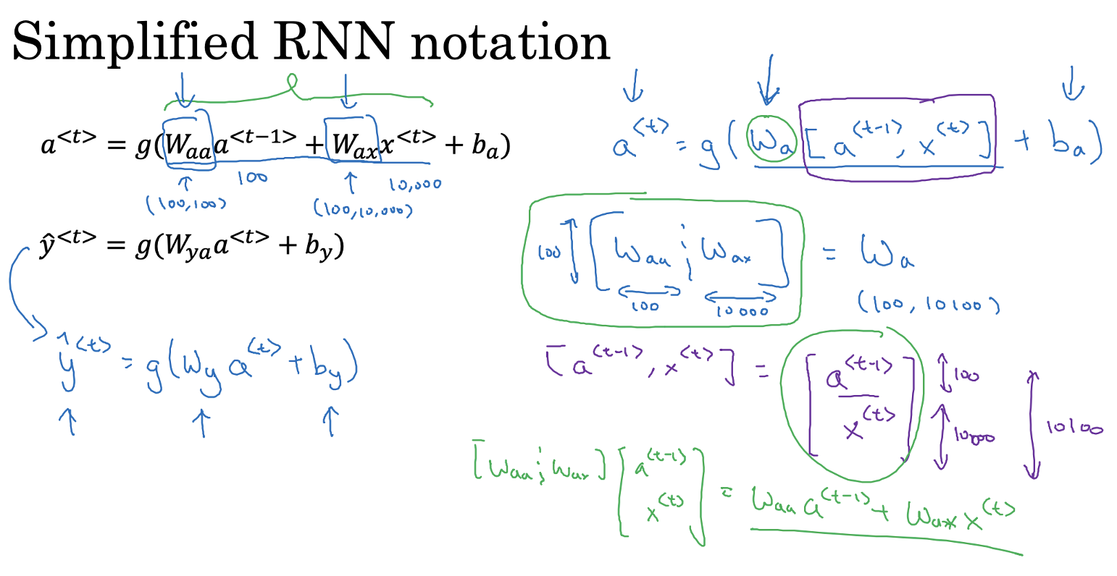

Slide 8
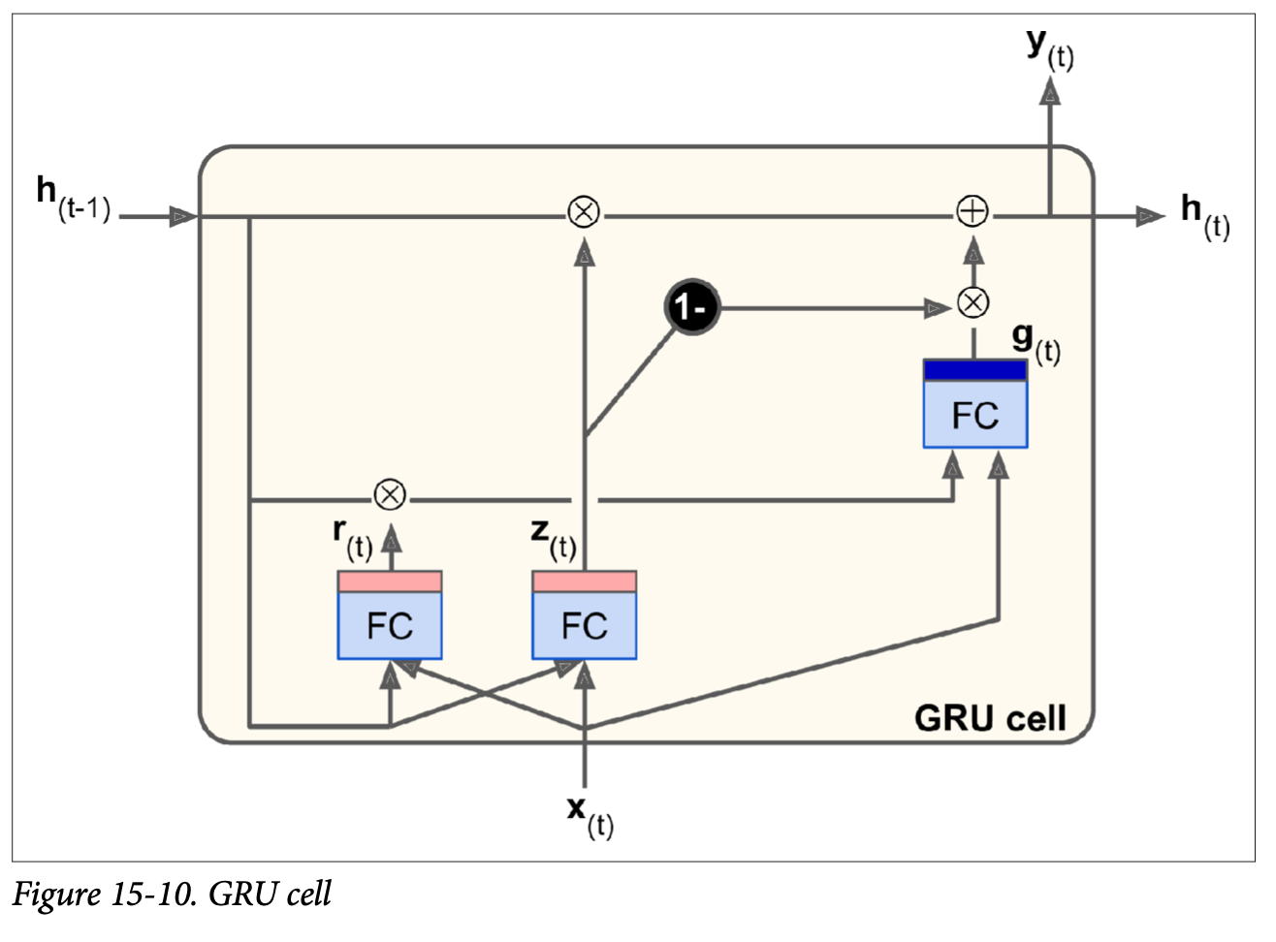
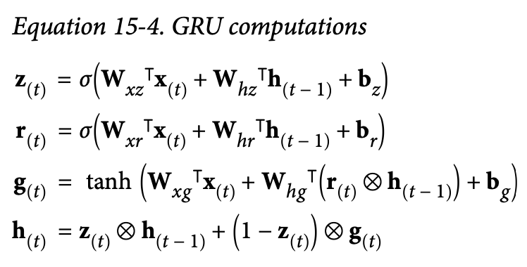

Gated Recurrent Unit (GRU)
Kyunghyun Cho et al., “Learning phrase representation using RNN encoder-decoder for statistical machine translation”, 2014

Slide 9
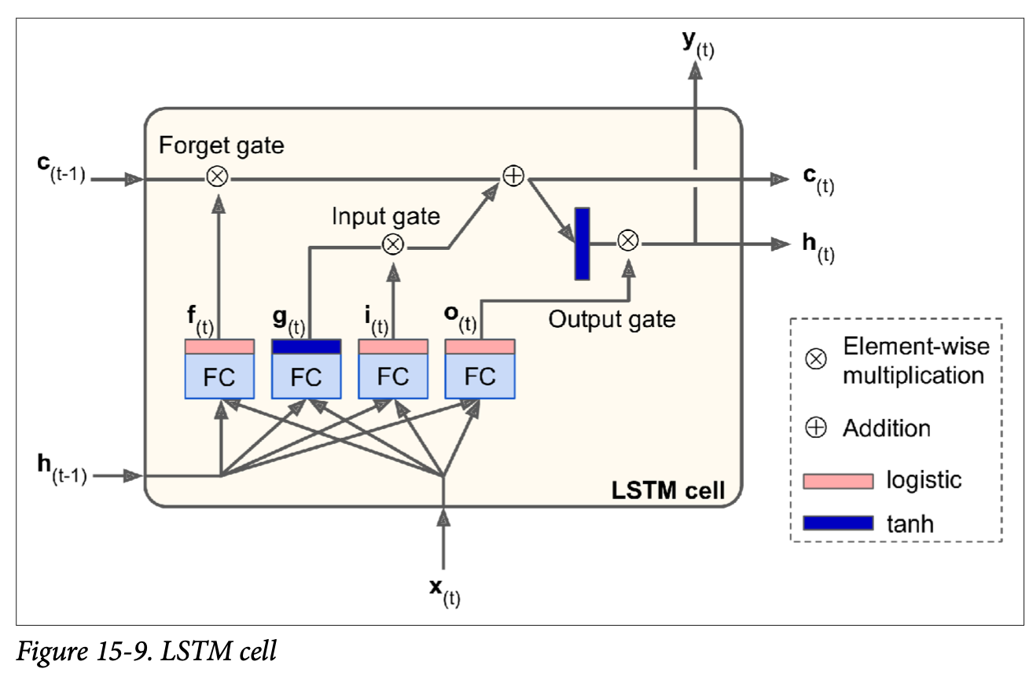
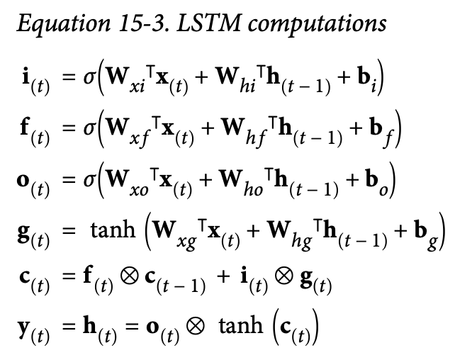
Long Short-Term Memory (LSTM)
long-term
short-term
Sepp Hochreiter and Jürgen Schmidhuber, “Long Short-term Memory”, 1997
Notes:
Sequence models by Andrew ng (Ex. Whether to use a singular or plural verb)
Many of the tricks we used in deep nets to alleviate the unstable gradients problem can also be used for RNNs: good parameter initialization, faster optimizers, dropout, and so on. However, nonsaturating activation functions (e.g., ReLU) may not help as much here; in fact, they may actually lead the RNN to be even more unstable during training. Why? Well, suppose Gradient Descent updates the weights in a way that increases the outputs slightly at the first time step. Because the same weights are used at every time step, the outputs at the second time step may also be slightly increased, and those at the third, and so on until the outputs explode—and a nonsaturating acti‐ vation function does not prevent that. You can reduce this risk by using a smaller learning rate, but you can also simply use a saturating activation function like the hyperbolic tangent (this explains why it is the default). In much the same way, the gradients themselves can explode. If you notice that training is unstable, you may want to monitor the size of the gradients (e.g., using TensorBoard) and perhaps use Gradient Clipping.

Slide 10
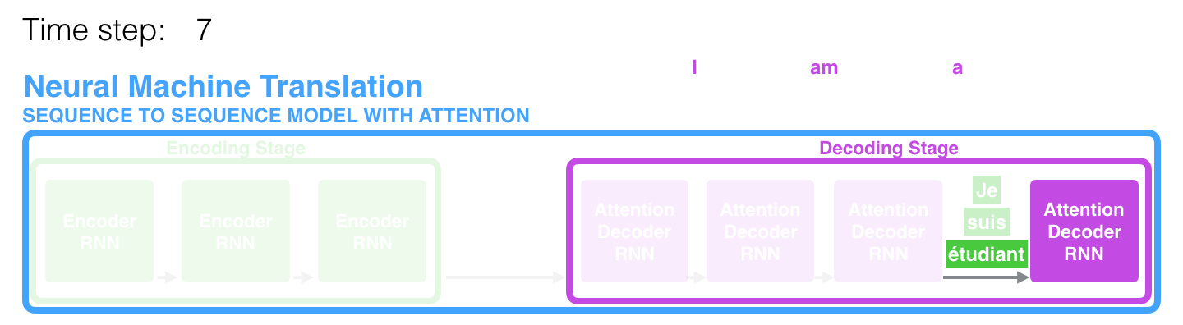
Let’s Pay Attention
The context vector turned out to be a bottleneck for these types of models. It made it challenging for the models to deal with long sentences. A solution was proposed in Bahdanau et al., 2014 and Luong et al., 2015. These papers introduced and refined a technique called “Attention”, which highly improved the quality of machine translation systems. Attention allows the model to focus on the relevant parts of the input sequence as needed.
At time step 7, the attention mechanism enables the decoder to focus on the word "étudiant" ("student" in French) before it generates the English translation. This ability to amplify the signal from the relevant part of the input sequence makes attention models produce better results than models without attention.

Slide 11
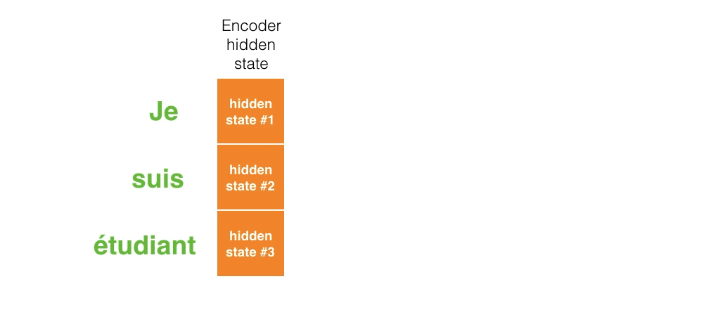
Let’s Pay Attention

Slide 12
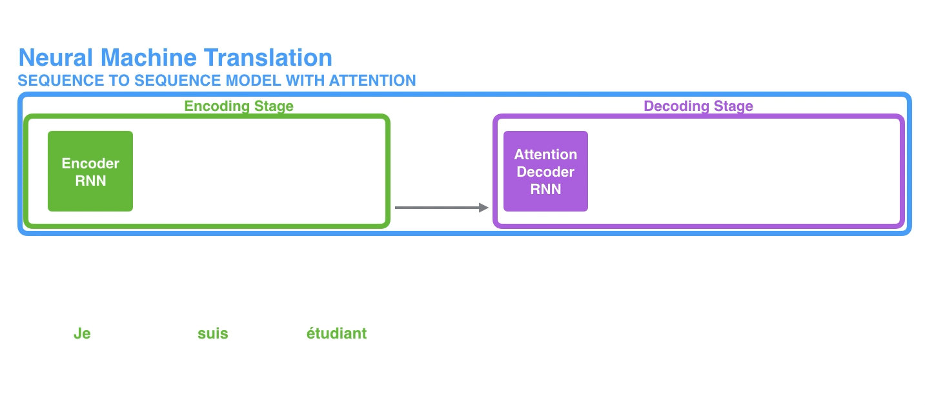
RNN with Attention
First, the encoder passes a lot more data to the decoder. Instead of passing the last hidden state of the encoding stage, the encoder passes all the hidden states to the decoder:

Slide 13
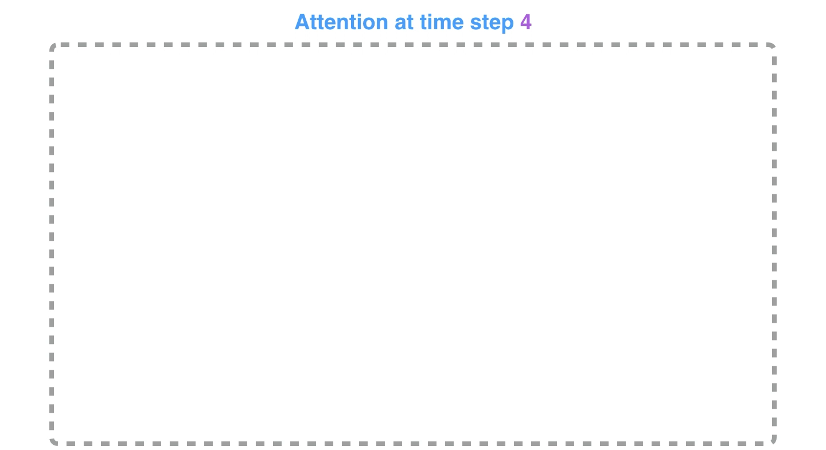
RNN with Attention
Second, an attention decoder does an extra step before producing its output. In order to focus on the parts of the input that are relevant to this decoding time step, the decoder does the following:
Look at the set of encoder hidden states it received – each encoder hidden states is most associated with a certain word in the input sentence
Give each hidden states a score (let’s ignore how the scoring is done for now)
Multiply each hidden states by its softmaxed score, thus amplifying hidden states with high scores, and drowning out hidden states with low scores

Slide 14
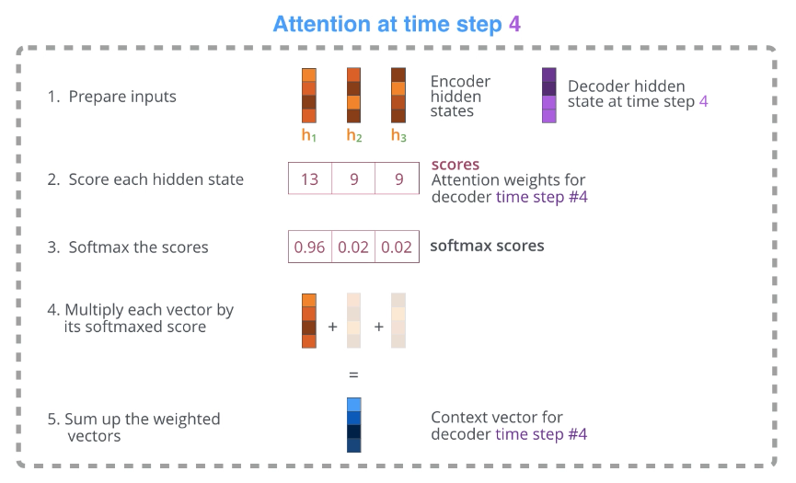
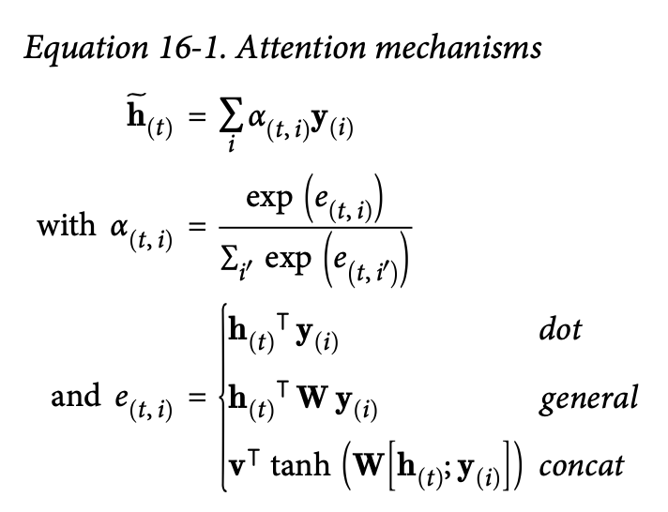
Attention Mechanism
References:
Minh-Thang Luong et al., “Effective Approaches to Attention-Based Neural Machine Translation,” 2015.
(Luong attention / Multiplicative attention)
Dzmitry Bahdanau et al., “Neural Machine Translation by Jointly Learning to Align and Translate,” 2014.
(Bahdanau attention / Concatenative attention / Additive attention)
i^{th} encoder output
t^{th} decoder time step
Minh-Thang Luong et al.
Dzmitry Bahdanau et al.
The scores measure how well each encoder’s output is aligned with the decoder’s current hidden state
This scoring exercise is done at each time step on the decoder side.

Slide 15
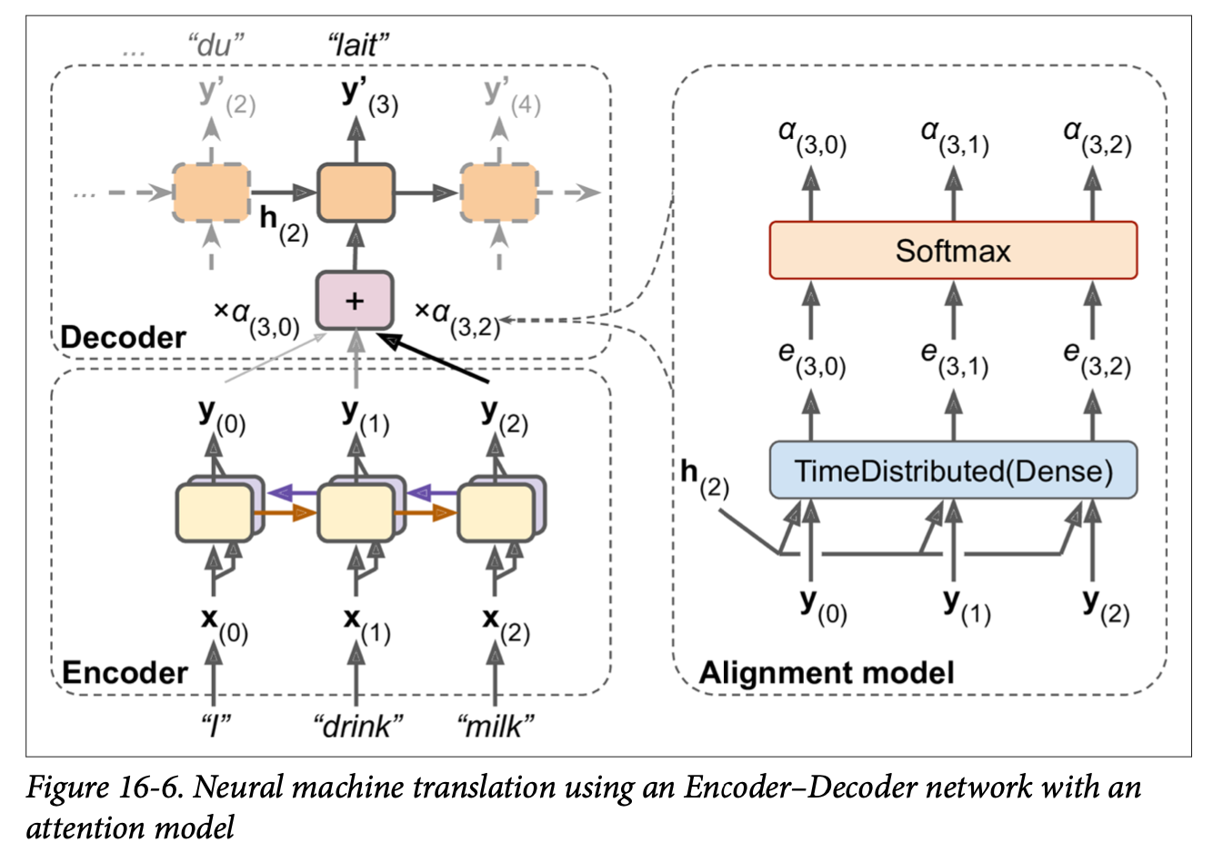
Attention Mechanism
i^{th} encoder output
t^{th} decoder time step
Minh-Thang Luong et al.
Dzmitry Bahdanau et al.
The scores measure how well each encoder’s output is aligned with the decoder’s current hidden state

Slide 16
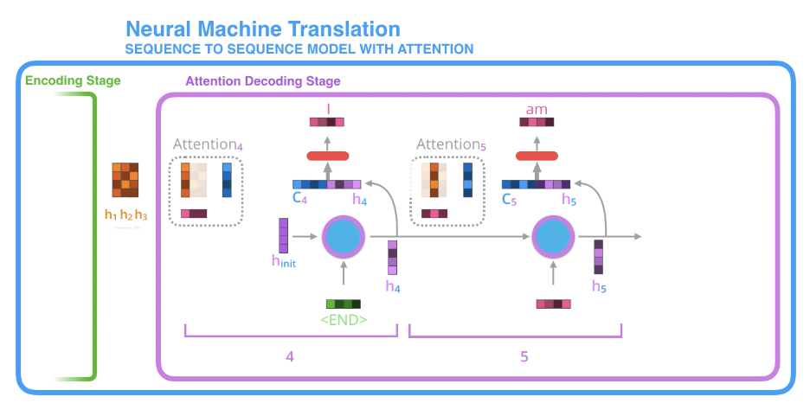
Decoder RNN with Attention
The attention decoder RNN takes in the embedding of the <END> token, and an initial decoder hidden state.
The RNN processes its inputs, producing an output and a new hidden state vector (h4). The output is discarded.
Attention Step: We use the encoder hidden states and the h4 vector to calculate a context vector (C4) for this time step.
We concatenate h4 and C4 into one vector.
We pass this vector through a feedforward neural network (one trained jointly with the model).
The output of the feedforward neural networks indicates the output word of this time step.
Repeat for the next time steps

Slide 17
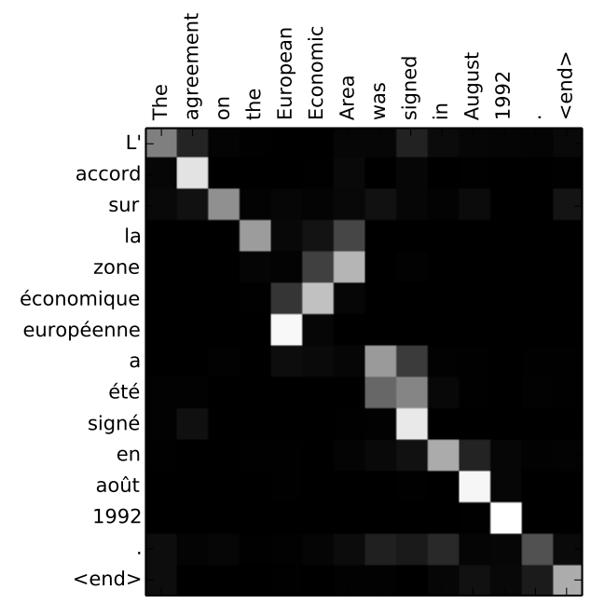
Attention Map
If you feel you’re ready to learn the implementation, be sure to check TensorFlow’s Neural Machine Translation (seq2seq) Tutorial.

Slide 18
Why Attention?
🛠 The info (a representation of this word) needs to be carried over many steps
→ Can’t we make it shorter?
💡 Attention mechanisms – Improvement for long sentences

Slide 19
Attention is All You Need
Transformer - a model that uses attention to boost the speed to train sequences
[parallelisation]

Slide 20
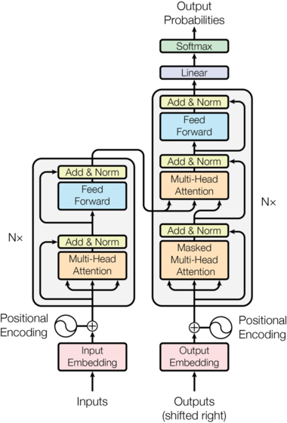
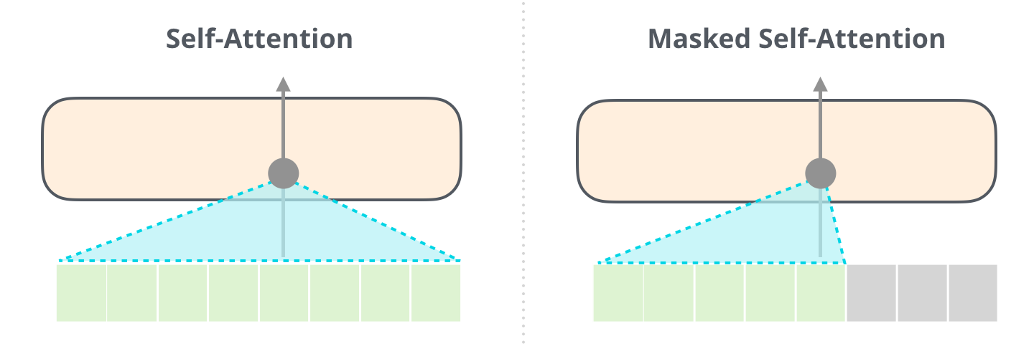

Transformer
Masked
Ref: https://arxiv.org/abs/1706.03762

Slide 21
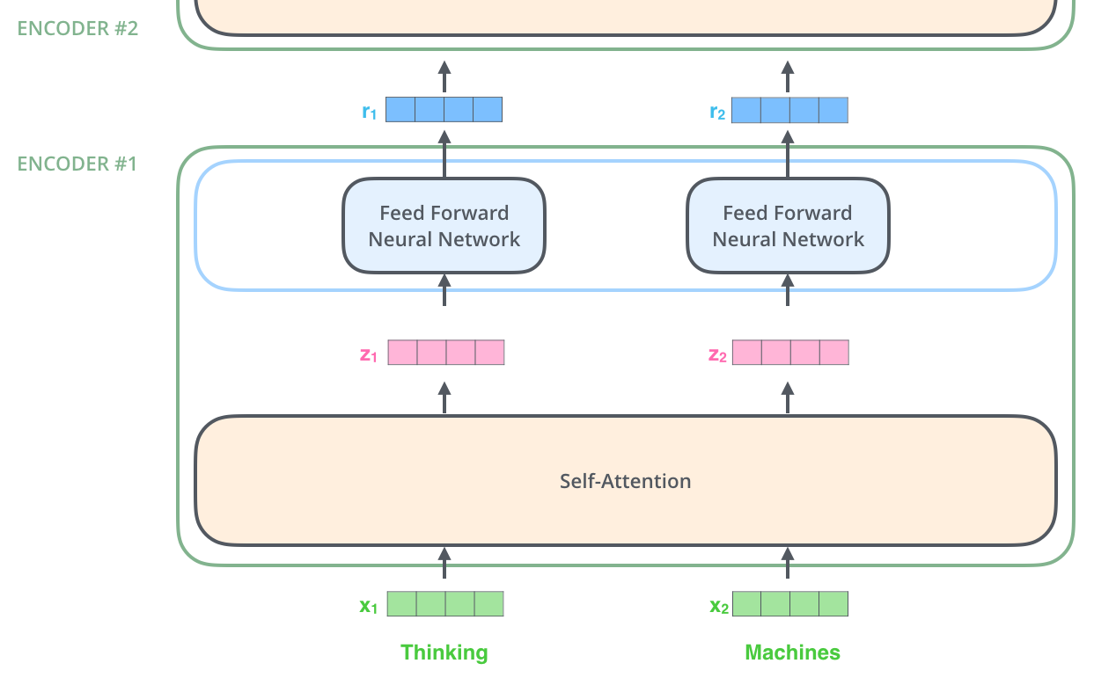
Transformer
Here we begin to see one key property of the Transformer, which is that the word in each position flows through its own path in the encoder. There are dependencies between these paths in the self-attention layer. The feed-forward layer does not have those dependencies, however, and thus the various paths can be executed in parallel while flowing through the feed-forward layer.
The word at each position passes through a self-attention process. Then, they each pass through a feed-forward neural network -- the exact same network with each vector flowing through it separately.
Ref: https://jalammar.github.io/illustrated-transformer/

Slide 22

Self-Attention
If you’re familiar with RNNs, think of how maintaining a hidden state allows an RNN to incorporate its representation of previous words/vectors it has processed with the current one it’s processing. Self-attention is the method the Transformer uses to bake the “understanding” of other relevant words into the one we’re currently processing.

Slide 23
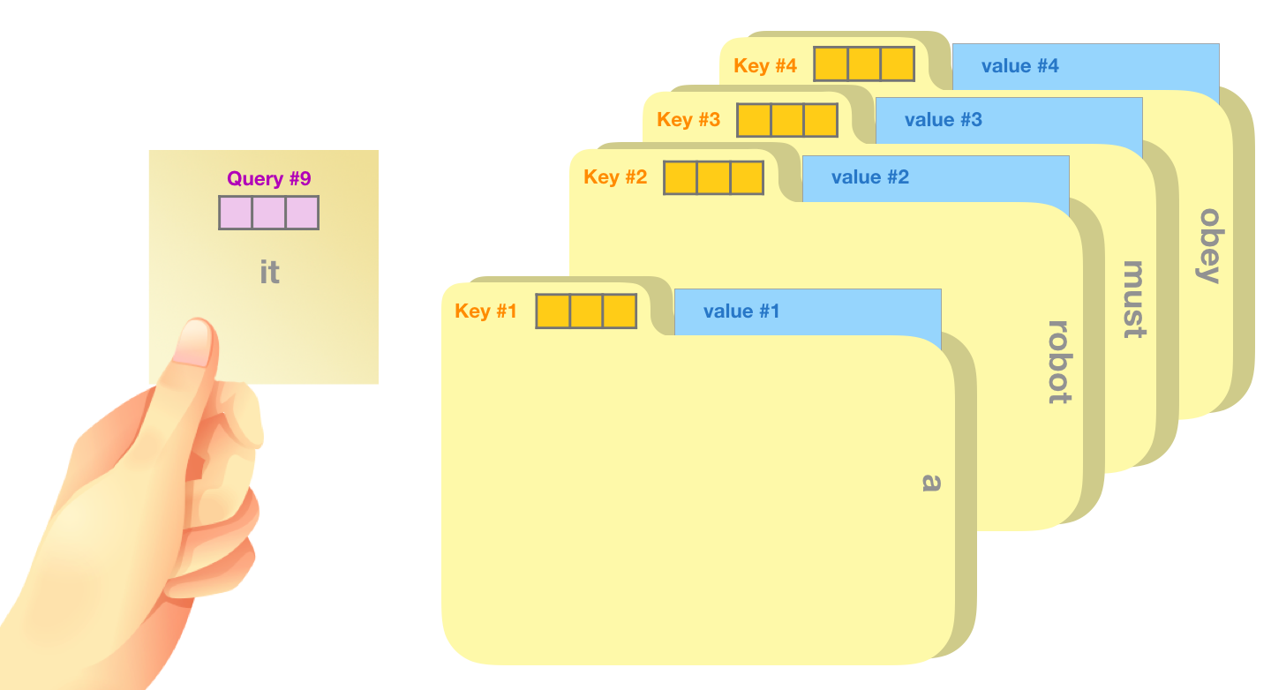
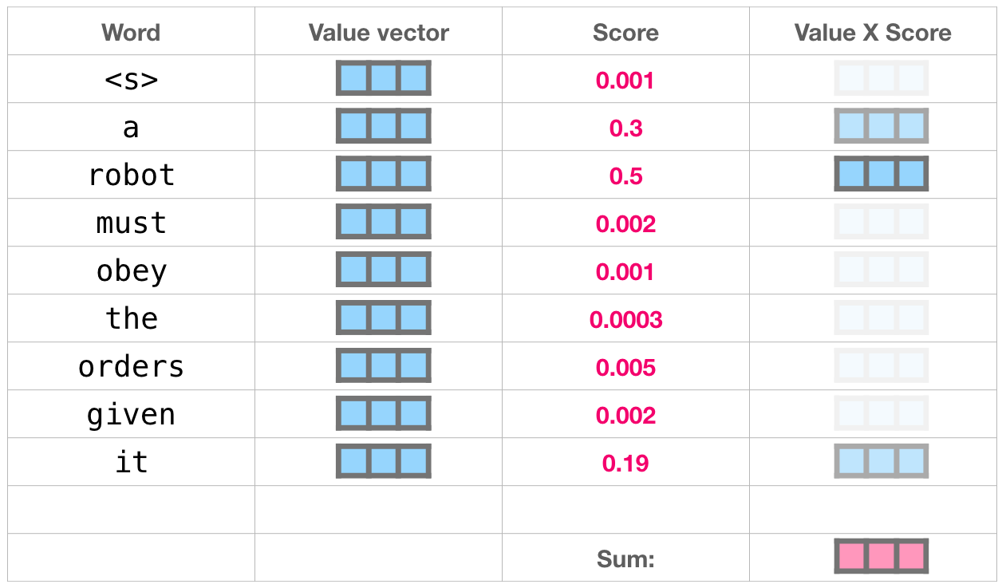



Self-Attention
Query: The query is a representation of the current word used to score against all the other words (using their keys). We only care about the query of the token we’re currently processing.
Key: Key vectors are like labels for all the words in the segment. They’re what we match against in our search for relevant words.
Value: Value vectors are actual word representations, once we’ve scored how relevant each word is, these are the values we add up to represent the current word.

Slide 24

Self-Attention
Query: The query is a representation of the current word used to score against all the other words (using their keys). We only care about the query of the token we’re currently processing.
Key: Key vectors are like labels for all the words in the segment. They’re what we match against in our search for relevant words.
Value: Value vectors are actual word representations, once we’ve scored how relevant each word is, these are the values we add up to represent the current word.

Slide 25
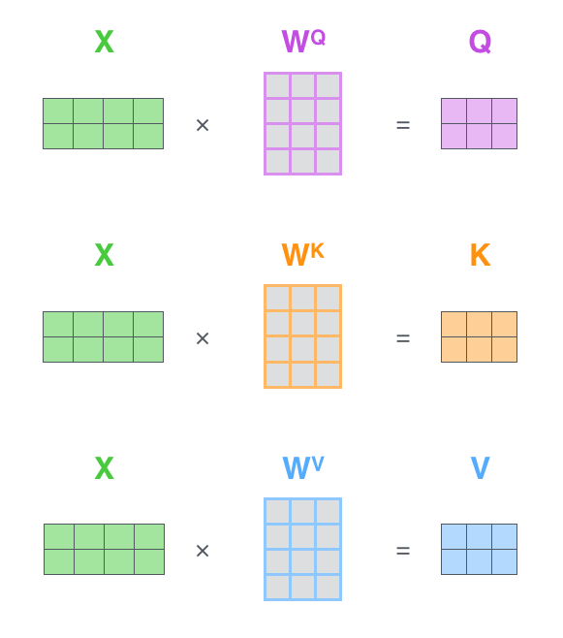



Self-Attention

Slide 26
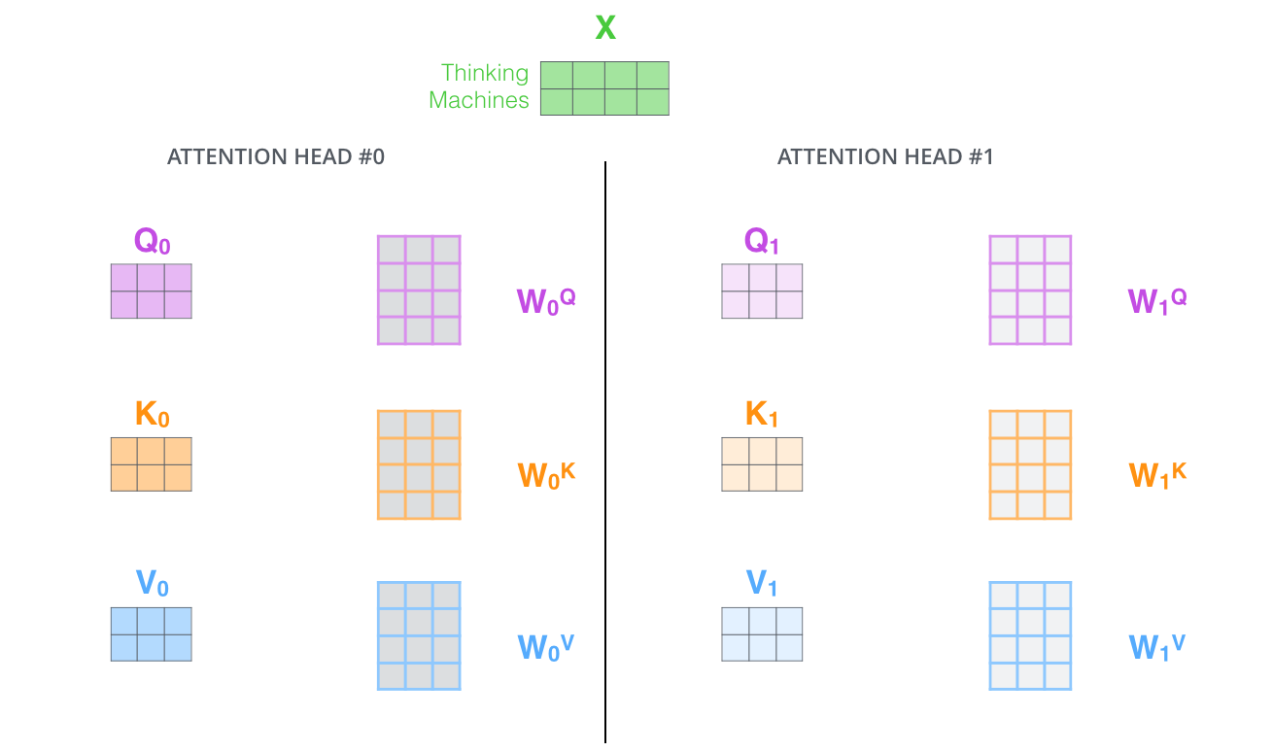
Multi-Head Attention

Slide 27
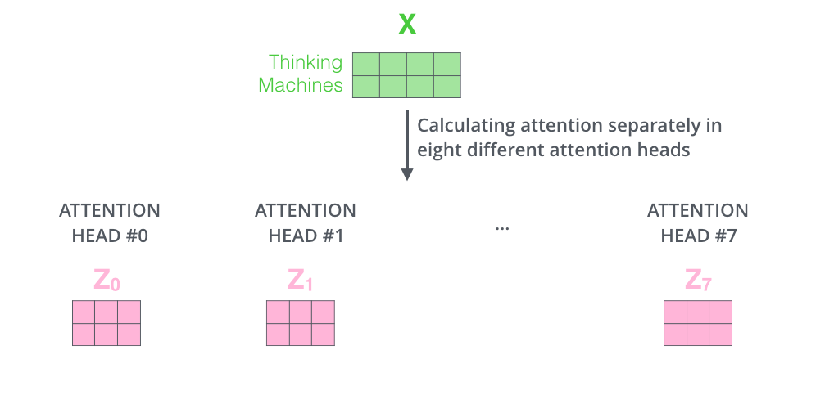
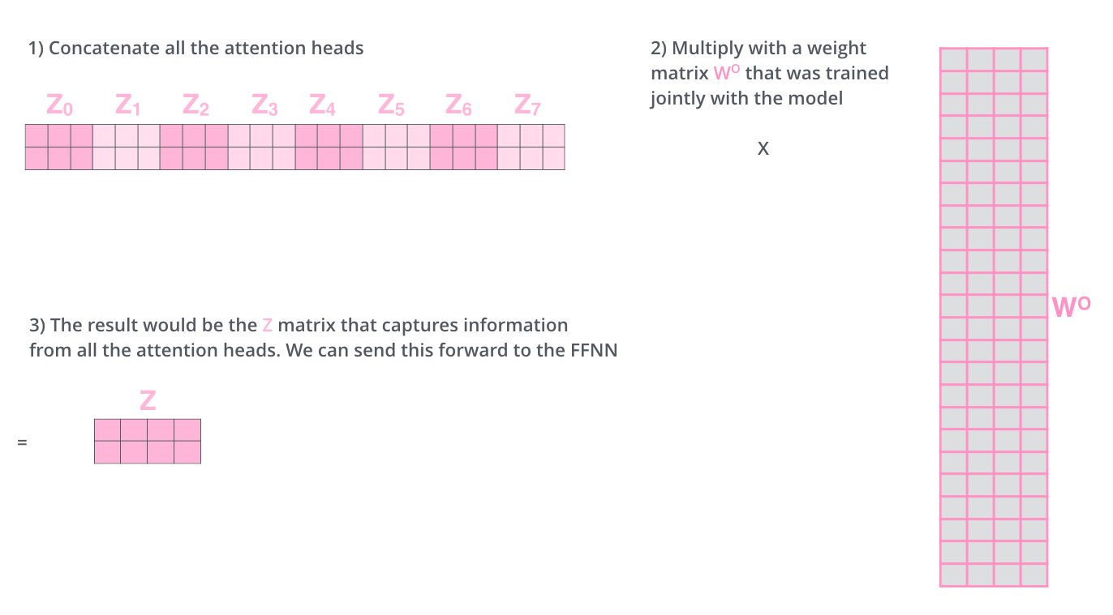
Multi-Head Attention

Slide 28

Multi-Head Attention

Slide 29
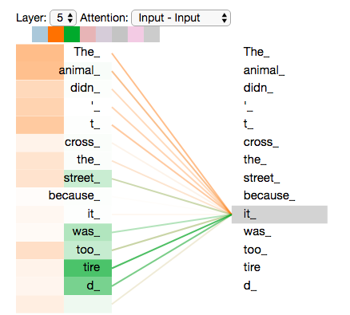
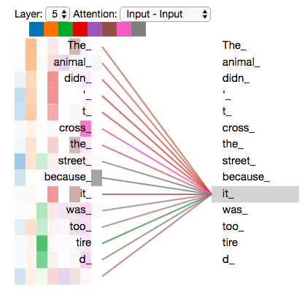
Multi-Head Attention

Slide 30
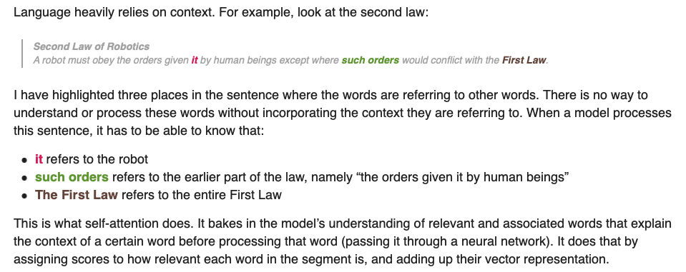
Why Self-Attention?

Slide 31
Why multi-heads?
The paper further refined the self-attention layer by adding a mechanism called “multi-headed” attention. This improves the performance of the attention layer in two ways:
It expands the model’s ability to focus on different positions. Yes, in the example above, z1 contains a little bit of every other encoding, but it could be dominated by the actual word itself. If we’re translating a sentence like “The animal didn’t cross the street because it was too tired”, it would be useful to know which word “it” refers to.
It gives the attention layer multiple “representation subspaces”. As we’ll see next, with multi-headed attention we have not only one, but multiple sets of Query/Key/Value weight matrices (the Transformer uses eight attention heads, so we end up with eight sets for each encoder/decoder). Each of these sets is randomly initialized. Then, after training, each set is used to project the input embeddings (or vectors from lower encoders/decoders) into a different representation subspace.

Slide 32
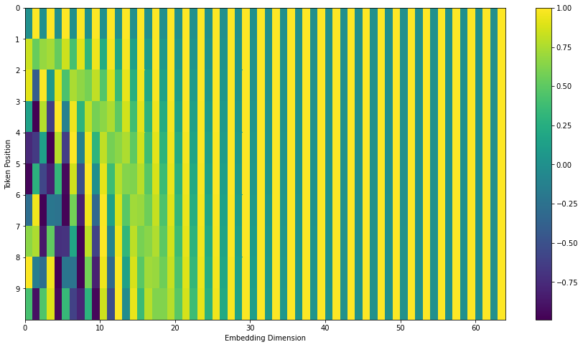
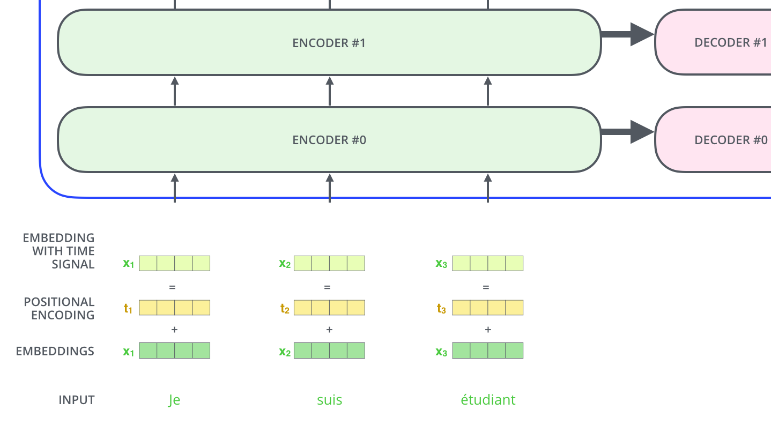
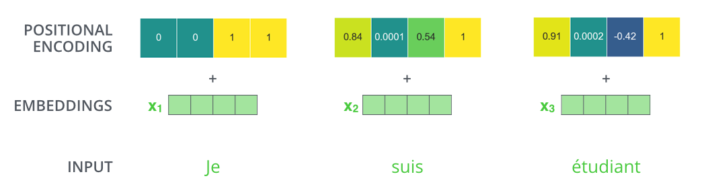
Positional Encoding
Representing the order of the sequence

Slide 33


The Residuals

Slide 34



The Decoder
The “Encoder-Decoder Attention” layer works just like multiheaded self-attention, except it creates its Queries matrix from the layer below it, and takes the Keys and Values matrix from the output of the encoder stack.

Slide 35
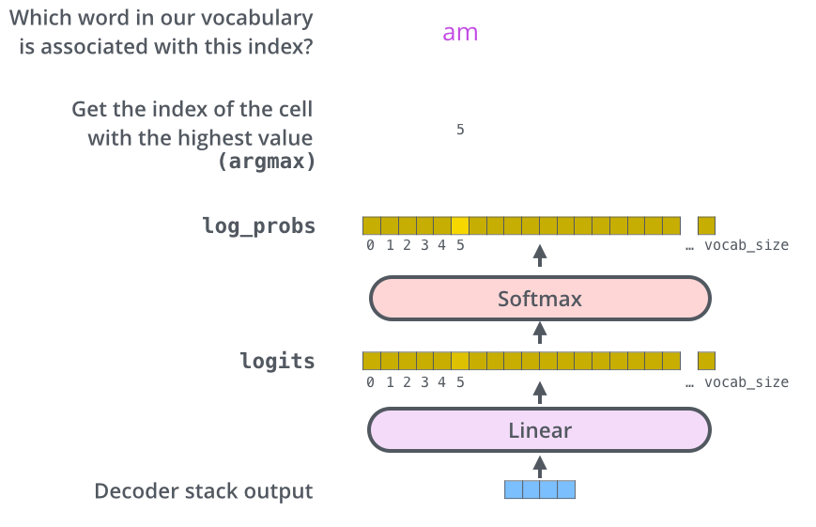
The Final Linear and Softmax Layer

Slide 36
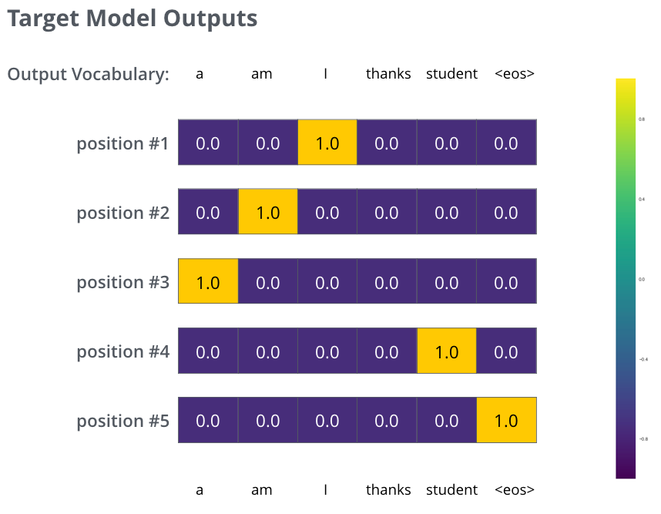
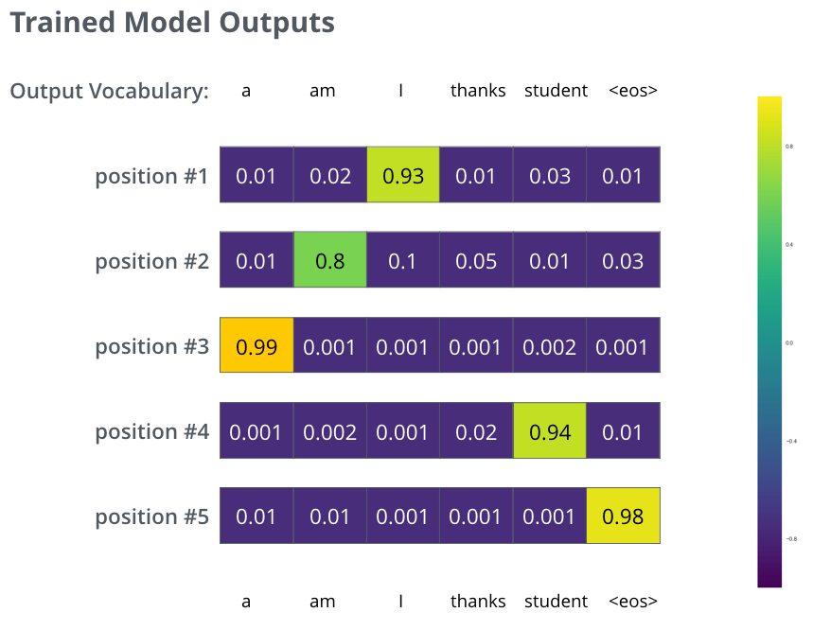
Training

Slide 37
Seq2Seq
Loss
Text
Tokenisation
Numeric vectors
Model
Output
Label
Encoder
Decoder

